Slide 1
Image transformation from camera to state space for robot navigation in a maze
Interaktívna firma “YOLO bolo”

Slide 2
Ovewiev
Main goal
Model overwiev
Dataset
Training of a custom model
Output and evaluation
Website

Slide 3

Main goal
The goal of this project is to detect and classify objects in images from the camera, extract data such as the position and size of the object for further use.
With the data we have obtained, it will be possible to create a representation of the environment understandable by GDDRL algorithm.

Slide 4
Model Overview
As the first step of our project, we will make an overview of object detection models, learn to work with them, compare them, and select the most suitable model for our project.
 | Complexity | Speed | Accuracy | Efficiency
Faster R-CNN | High | Slow | High | Less efficient
YOLO | Medium | Fast | Medium | Efficient
SSD | Low | Fast | Low | Efficient

Slide 5
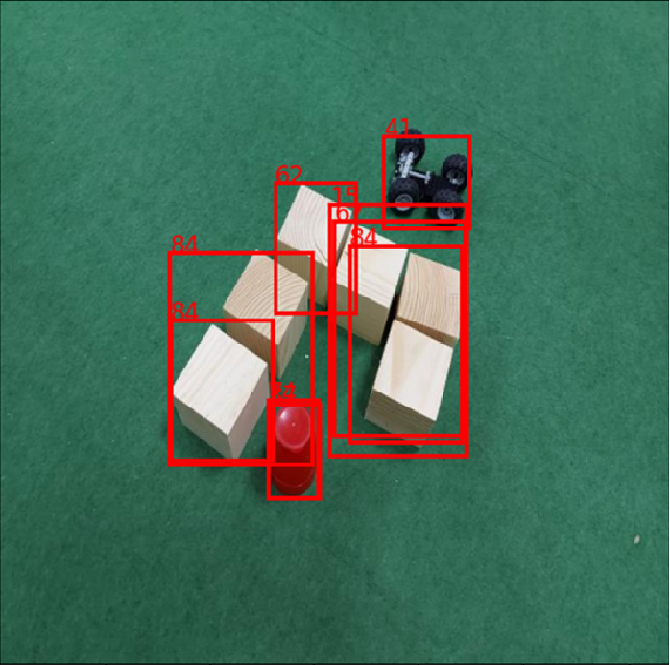
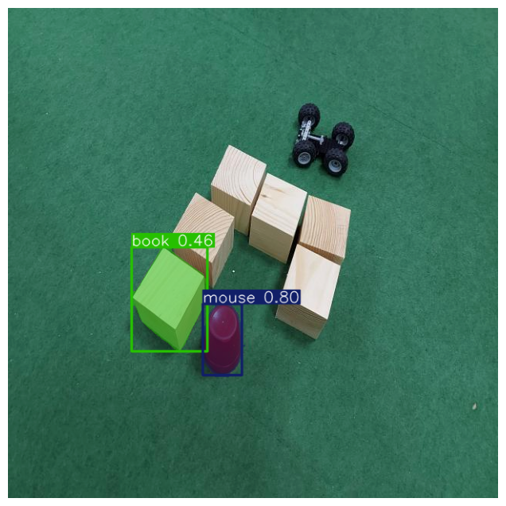
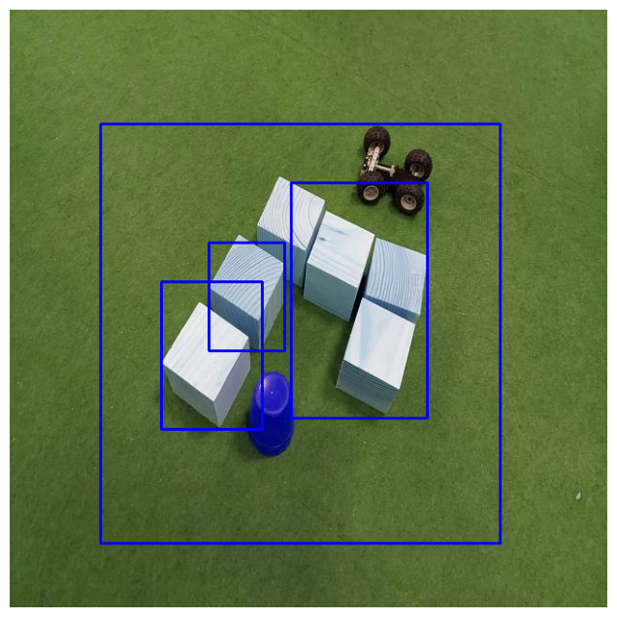
Model Overview
We tested each model to see how well it recognizes the necessary objects in our photos.
Faster R-CNN
YOLO
SSD

Slide 6
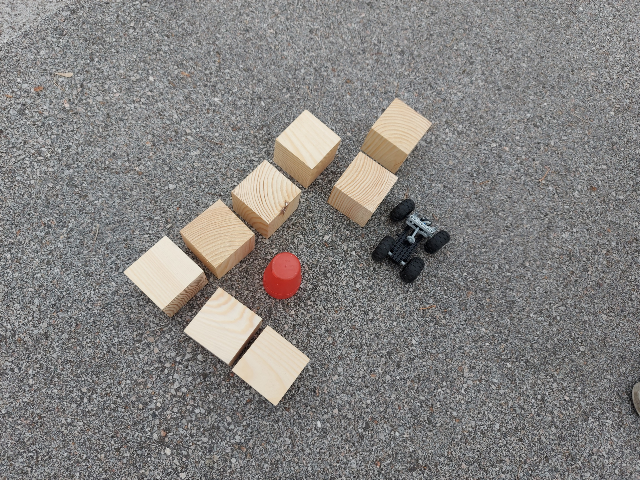
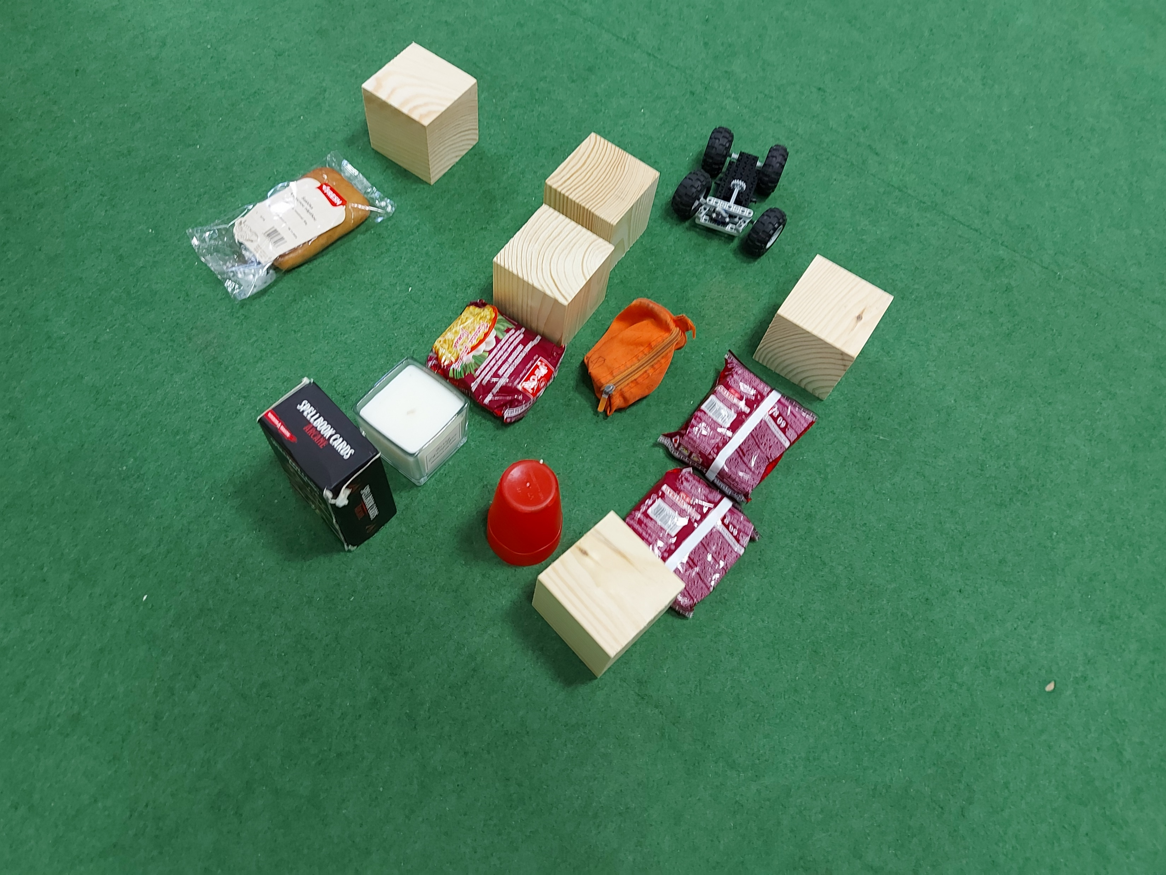
Dataset
Since none of the pre-trained models gave us satisfactory results, the next step is to create a dataset for further training of the model.
The dataset contains a total of
890 different photos on which
we want to recognize 3 main
classes of objects: finish,
robot, and obstacle, where
an obstacle is any object other than the target or the robot.

Slide 7
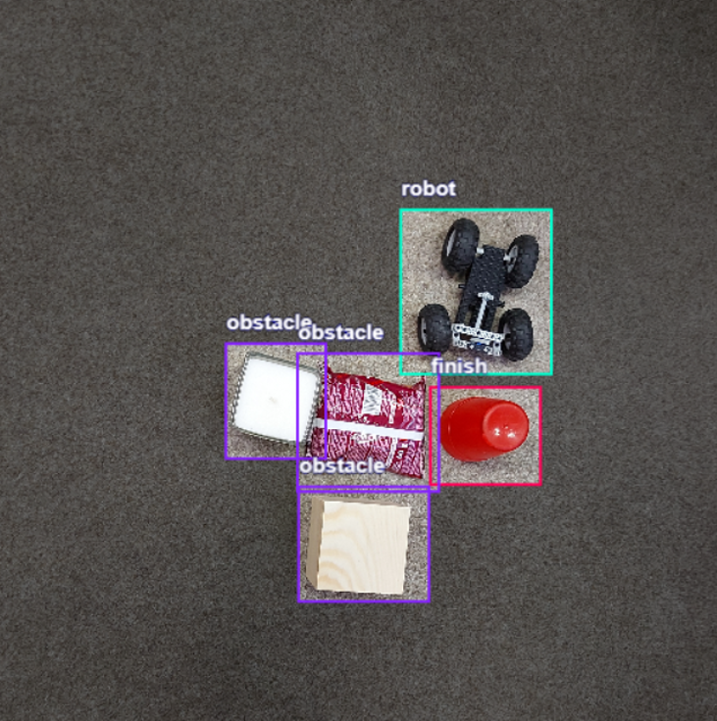
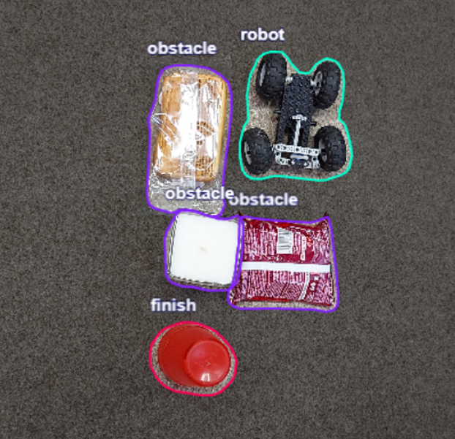
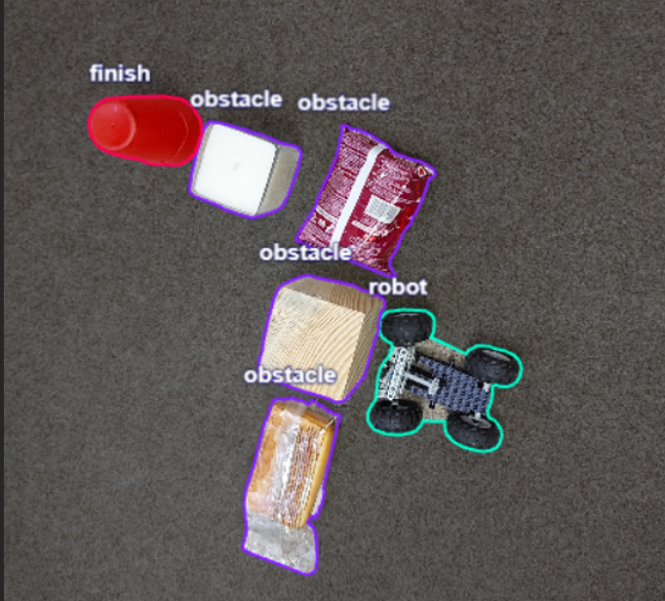
Annotation
During labeling, we considered these types and decided on Smart-polygons using AI from segment anything, which greatly simplified the entire labeling process.
Smart-polygon (segment anything)
Bounding-box
Smart-polygon

Slide 8
Dataset
The number of instances of a given class in our dataset:
Finish | 850
Obstacle | 5302
Robot | 882
For training, we divided the dataset as follows:
Train | 70%
Test | 20%
Validation | 10%

Slide 9
Dataaset preprocesing and augmentation
Resize to 640x640
For training purposes, we further expanded the training dataset by using data augmentation techniques:
  Flip: horizontal
  90° rotate clockwise
  90° rotate counter-clockwise
Therefore, the overall division of our data before training looked like this
Train | 1770
Test | 177
Validation | 90

Slide 10
Training of custom model
During training, we utilized a pre-trained model on the COCO dataset: yolov8s
Considering that we already had a pretrained model, we didn't need many training epochs. Therefore, we set the number of epochs to 15 which was sufficient.
We set the batch size to 16 image size to 640.

Slide 11
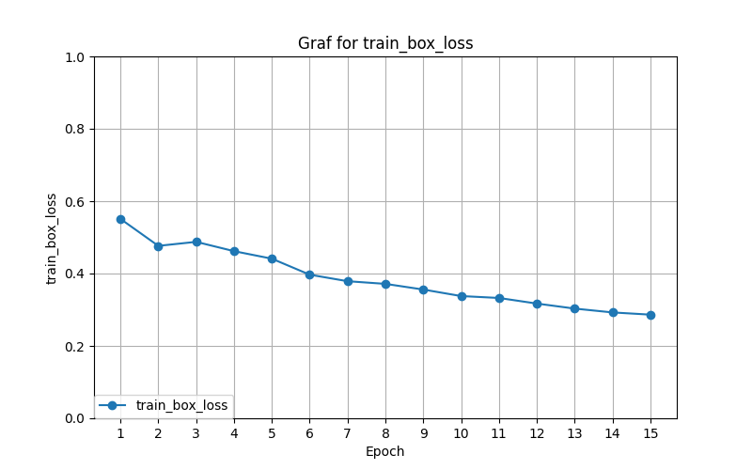
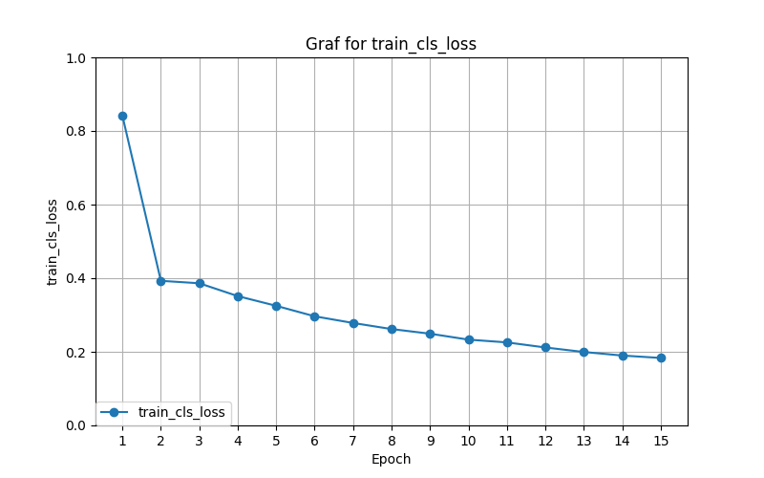
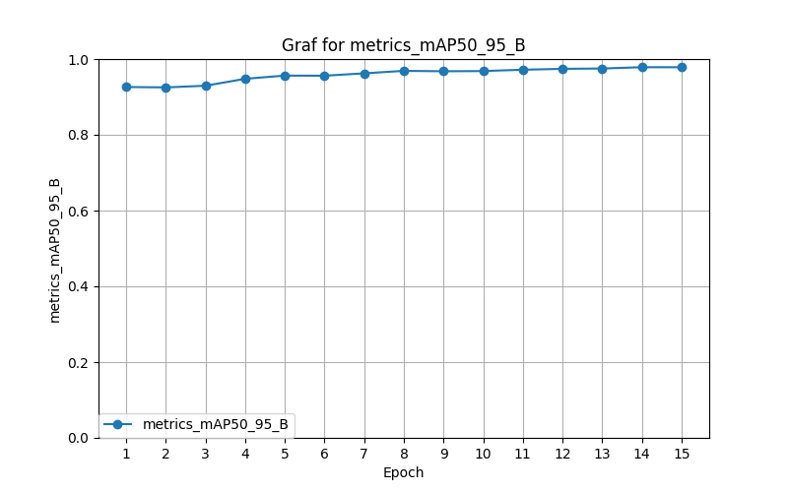
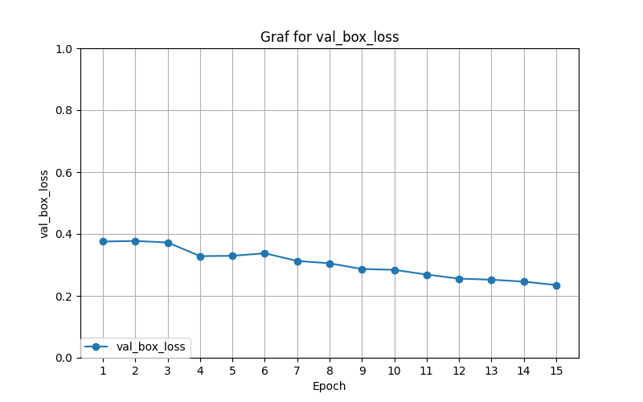
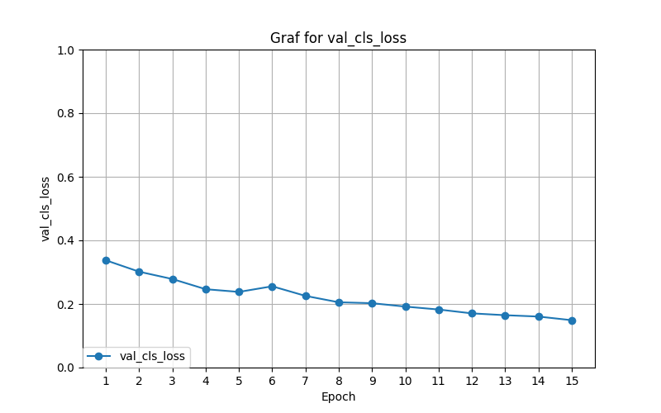
Output and evaluation

Slide 12
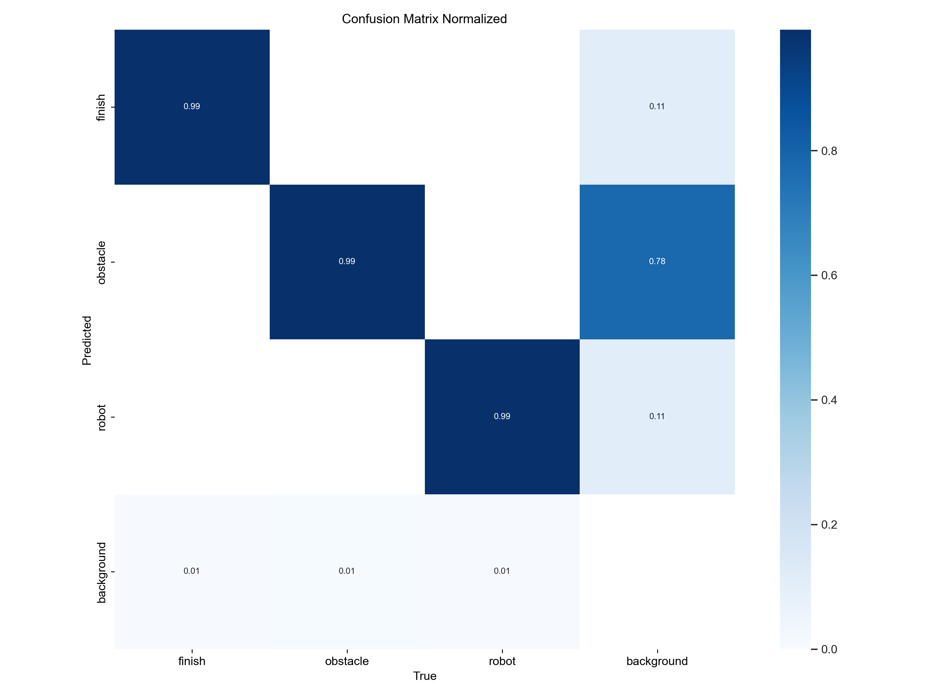
Confusion metrix
Based on this confusion matrix, we can confidently state that we are very satisfied with the project results and the error rate is minimal.

Slide 13
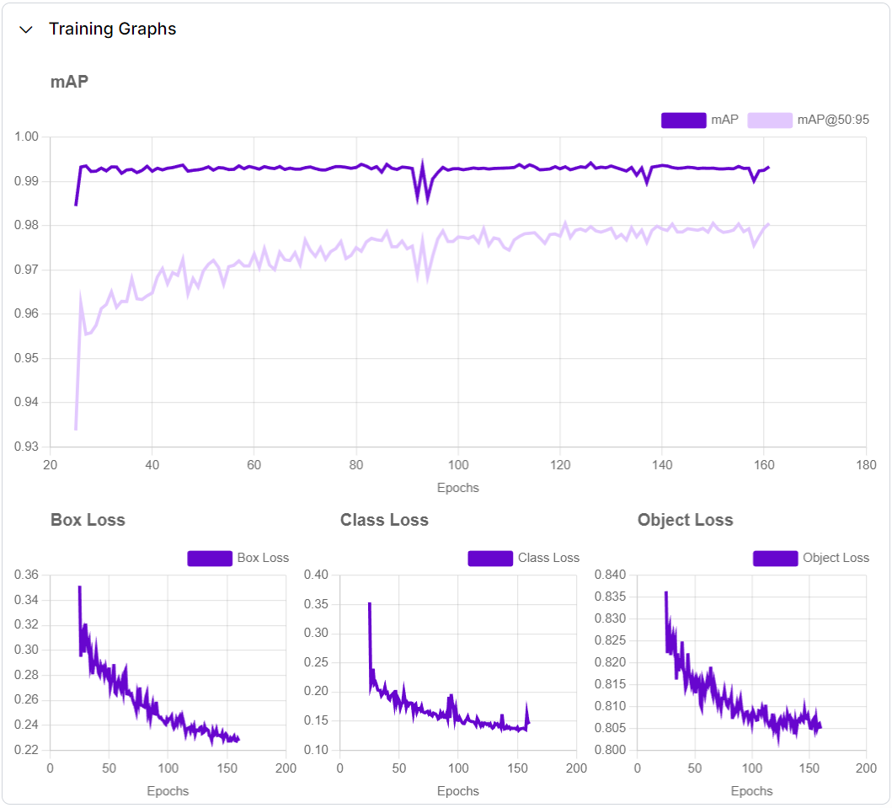
Training on cloud
Thanks to the Roboflow platform, we also had access to a server on which we could train our model. These are the data from the training.

Slide 14
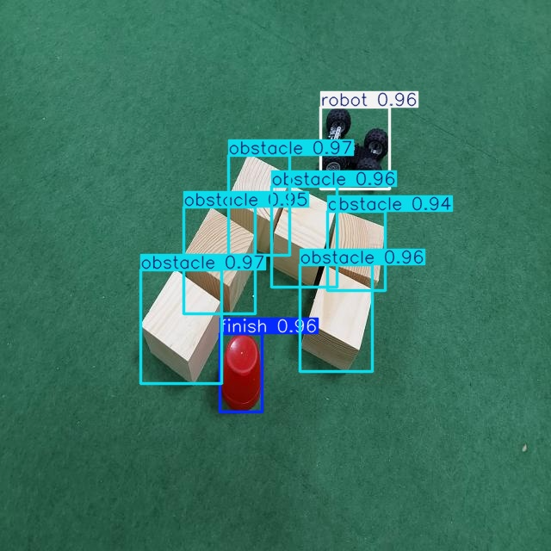

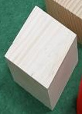






Results

Slide 15
Results
 | X | Y | Width | Height
obstacle | 210.4241 | 379.5570 | 94.1480 | 132.5049
obstacle | 301.0181 | 238.3481 | 71.4873 | 116.6005
obstacle | 390.6394 | 369.8573 | 84.2901 | 123.8661
finish | 279.5795 | 432.5599 | 49.0090 | 91.0701
obstacle | 353.3642 | 275.1150 | 76.0358 | 117.5965
robot | 412.2075 | 172.2550 | 79.9426 | 95.0810
obstacle | 254.8645 | 302.5593 | 82.4636 | 123.1585
obstacle | 413.9838 | 291.6132 | 66.4069 | 92.6936

Slide 16
Website
If you would like to tryout our model on some photos you can do so on this link: https://detect.roboflow.com/?model=yolomaze&version=1&api_key=liX6atpz4NLd2EXmTdNA

Slide 17
Conclusion
While we are pleased with the current performance of our object detection model, we recognize that there is always room for improvement. Future work could focus on enhancing the model's robustness by expanding the dataset with more diverse and challenging images, exploring advanced data augmentation techniques, and fine-tuning for better generalization.

Slide 18
Thank you for your attention
If you have any questions, feel free to ask :D

